Slide 1

Rising Temperatures
Developing a model to predict human health impacts
from a changing climate
Emily Nilson
Data Science Batch 625
General Assembly
Notes:
https://dailybruin.com/2017/10/29/the-quad-after-last-weeks-record-setting-heat-wave-some-tips-for-the-next-one/

Slide 2
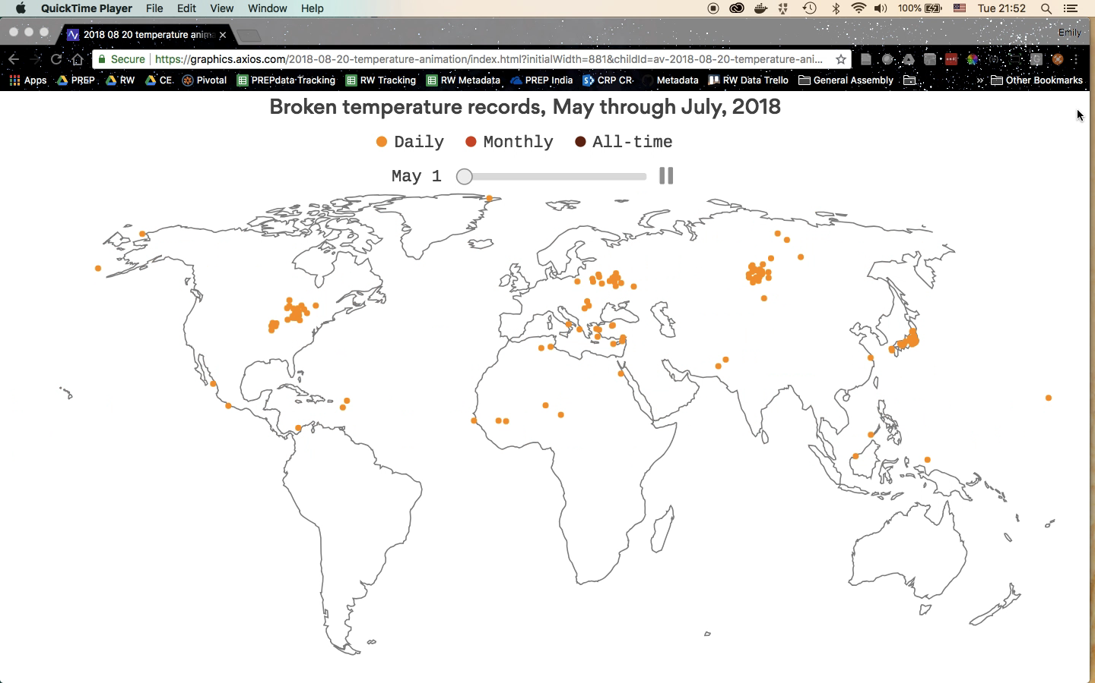
It’s been a hot summer…
Adapted from Robert A. Rohde / Berkeley Earth; Map: Harry Stevens/Axios
https://www.axios.com/heat-records-temperature-climate-change-map-f82a017b-4383-43d0-ae52-42517138b108.html
Notes:
Our planet is getting warmer. This summer has [set records](https://www.washingtonpost.com/news/capital-weather-gang/wp/2018/07/03/hot-planet-all-time-heat-records-have-been-set-all-over-the-world-in-last-week/?utm_term=.117468c8c1a6) in the Northern Hemisphere, from [Europe to Japan to North America](https://www.cnn.com/2018/07/23/world/global-heatwaves-climate-change-wxc/index.html), and it is going to be one of the [hottest summers on record](https://www.cnn.com/2018/07/28/us/2018-global-heat-record-4th-wxc/index.html).

Slide 3
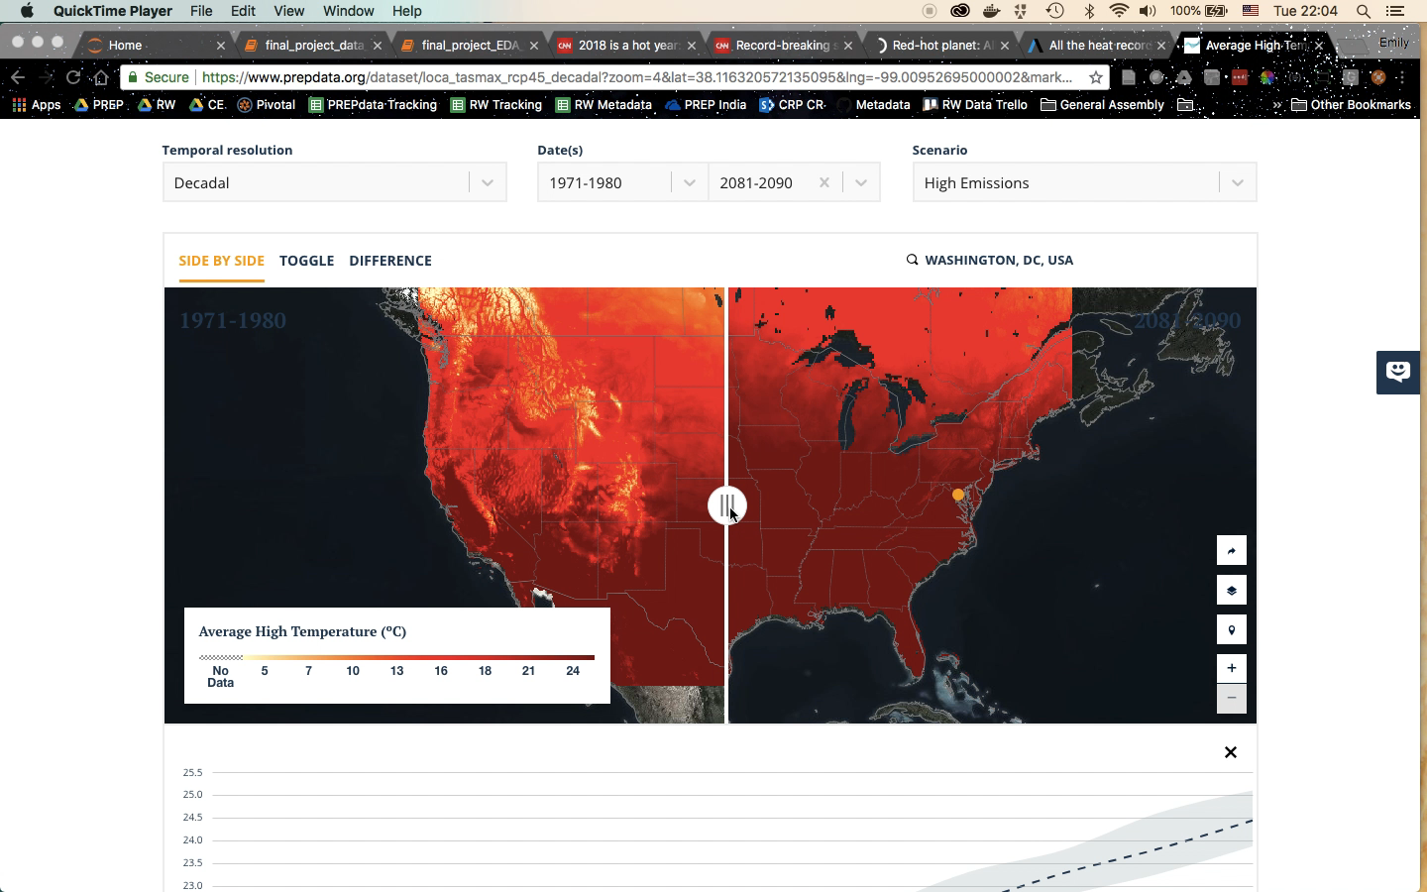
...and temperature is expected to increase
Average High Temperature, as derived from LOCA
Obtained from PREPdata (https://www.prepdata.org/)

Slide 4
Extreme heat impacts human health
Understanding how temperatures are expected to change and how many people could be vulnerable to heat-related health impacts is vital to be able to take measures to mitigate risk.
Problem
Statement
Goal
Develop a model to predict heat-related hospitalizations based on climate indicators that has some predictive value.
Notes:
E.g., raise awareness of the dangers of high temperatures, ensure electric grid reliability to power air conditioners, ensure ample capacity for hospitals and medical facilities to treat patients, etc.

Slide 5


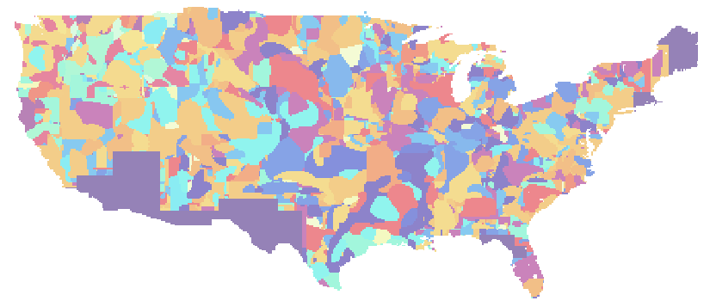
Data Sources
Climate Indicators
Hospitalizations
Climate API
LOCA Statistical Downscaling
(Localized Constructed Analogs)
Pierce et. al
Scripps Institution of Oceanography
National Environmental Public Health Tracking Network

Slide 6


Data: Selected Climate Indicators
Average High Temperature
Calculated by aggregating daily average high temperatures. It is an appropriate metric for probable long term temperature trends.
[tasmax]
Extreme Heat
Events
Counts the total times the daily average maximum temperature is above the 99th percentile of historic observations. It is an appropriate indicator for understanding deviations from normal climatic extremes.
[xhe]
Heat Wave
Incidents
Counts the days the daily high temperature exceeds 5˚C above historic average high temperature norms for at least 5 consecutive days. Frequency, duration, and intensity predictions of heat waves are very important for health and emergency services planning.
[hwi]

Slide 7
Collecting Data: Climate API
Querying the API: Example Querystring
Unique Azavea City ID
Climate Scenario
https://app.climate.azavea.com/api/climate-data/9/RCP85/indicator/average_high_temperature/?dataset=LOCA&years=2006&units=F&agg=median
Climate Indicator
Dataset
Year
Unit (°)
Aggregator
Collected yearly data for 3 climate indicators for 2006-2010 for 23 cities (*limited by CDC data)

Slide 8
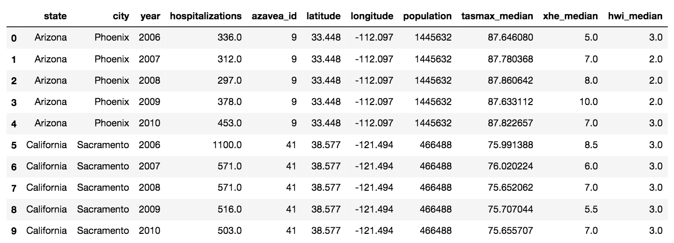
Compiled Data
Each observation = City, Year

Slide 9
Assumptions & Known Issues
Climate data is inherently complex
Hospitalizations are by state; climate indicators by point
Ideally: summarize climate data by state polygon
Hospitalization data isn't as complete as I'd hoped

Slide 10
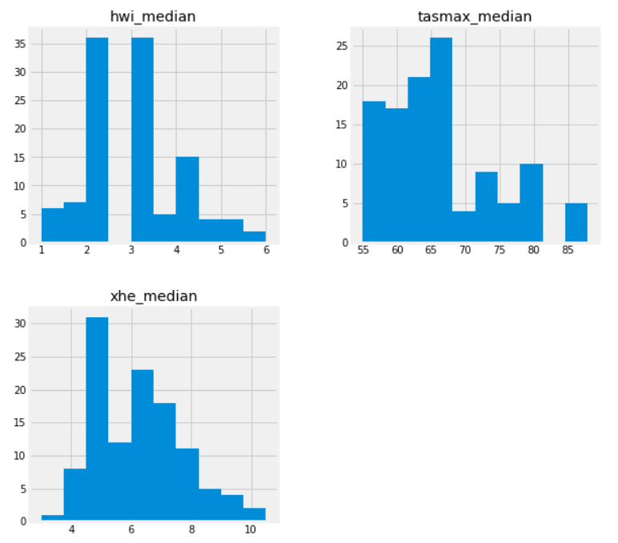
EDA: Distribution of Climate Indicators (X)

Slide 11
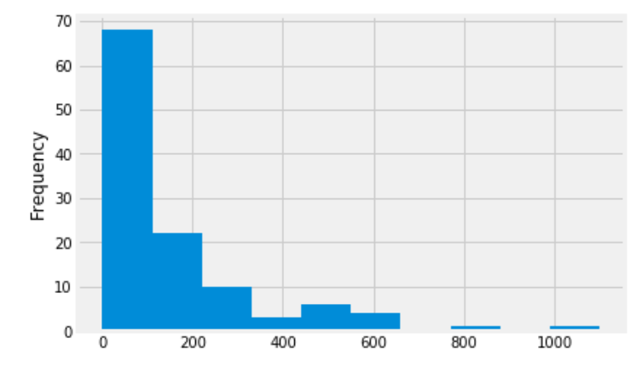
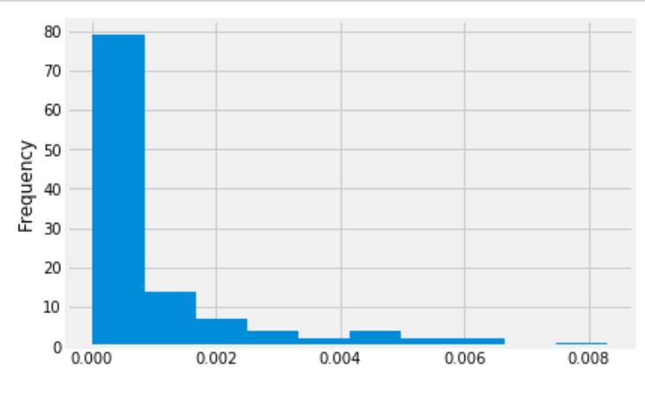
EDA: Distribution of Hospitalizations (y)
Number of Hospitalizations
Added
Hospitalization
Rate

Slide 12
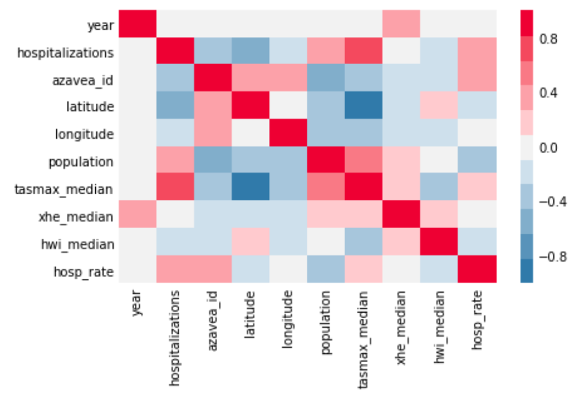
EDA: Heatmap
Avg High Temp vs.
# Hospitalizations

Slide 13
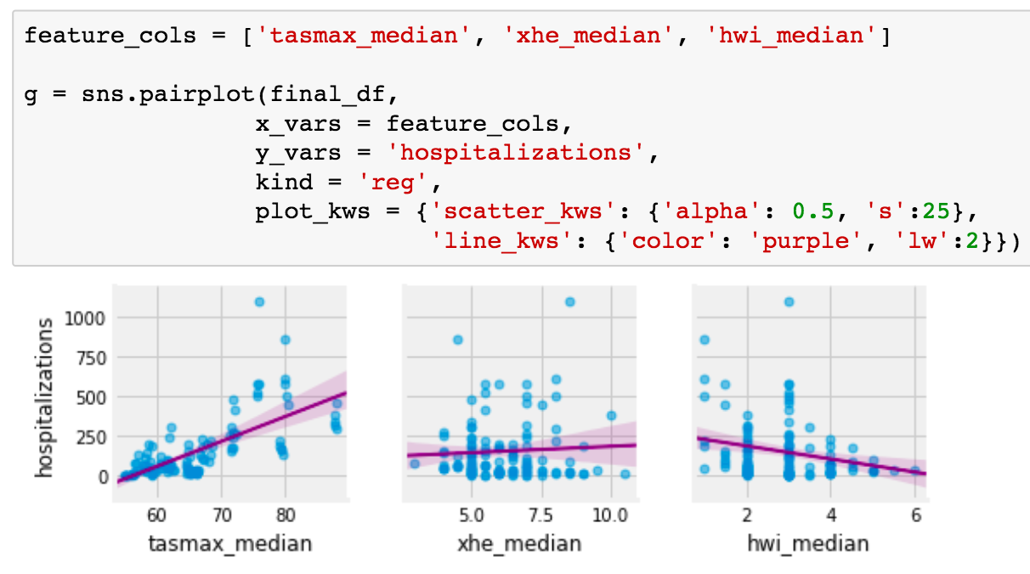
EDA: Climate Indicators & Hospitalizations

Slide 14
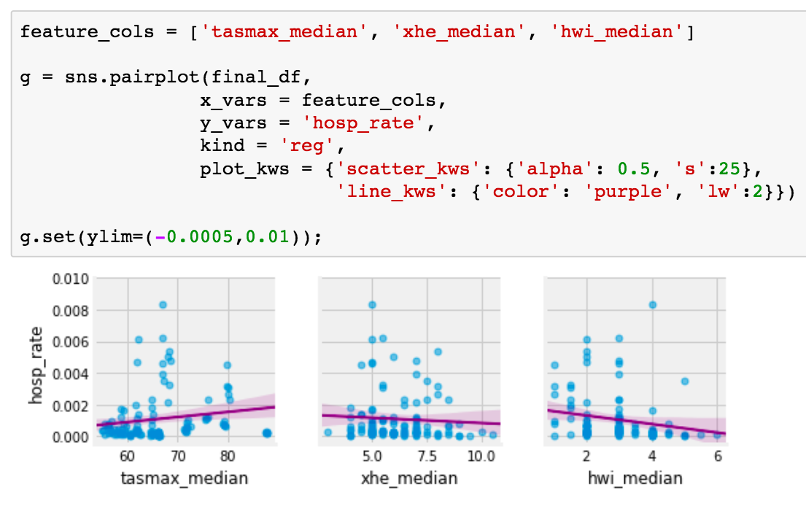
EDA: Climate Indicators & Hosp Rate

Slide 15
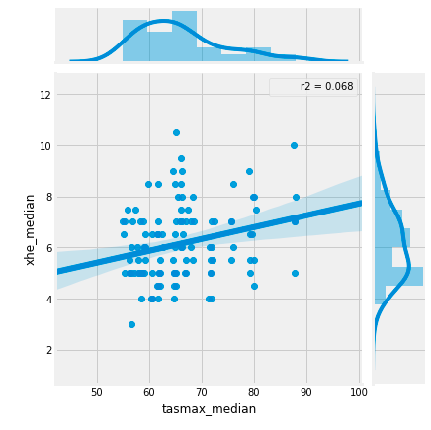
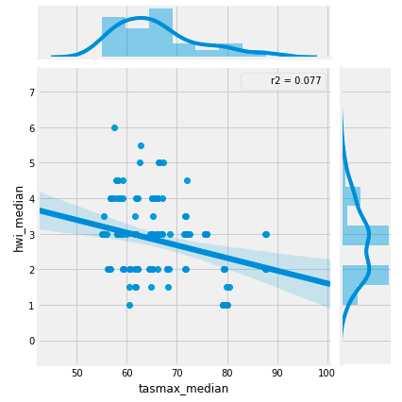
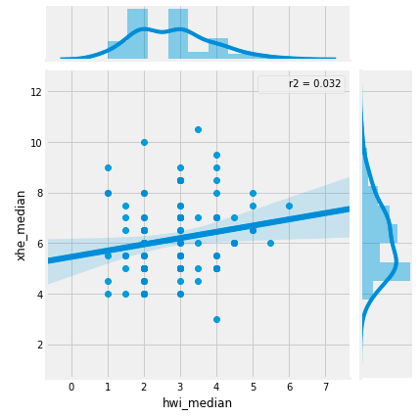
EDA: Collinearity?
Climate indicators not correlated with each another

Slide 16
Linear Regression Model
Steps:
Calculate null model
Establish baseline model with entire dataset
Since ultimate goal would be to train data on one timeframe and apply it to another (e.g., climate projections for the future), manually separate data into training and testing sets
Training
2006-2009
Testing
2010

Slide 17
Linear Regression Model
Variations on Models:
Number of Hospitalizations vs. Hospitalization Rate
All 3 climate indicators, 2 climate indicators (tasmax + xhe), 1 climate indicator (tasmax)

Slide 18
Linear Regression Results
Comparing RMSE: Number of Hospitalizations
Baseline (Entire Dataset) | Null Model (Average) | All 3 Climate Indicators | Avg. High Temp + Ext. Heat Events | Average High Temp Only
125.901 | 187.265 | 149.119 | 148.83 | 153.736
Not great… but better than the null model!

Slide 19

Linear Regression Results
Comparing RMSE: Hospitalization Rate
Baseline (Entire Dataset) | Null Model (Average) | All 3 Climate Indicators | Avg. High Temp + Ext. Heat Events | Average High Temp Only
0.00146 | 0.00155 | 0.00213 | 0.00212 | 0.00214
Models using number of hospitalizations have some predictive value

Slide 20
Linear Regression Summary
Best-performing Linear Regression model: predicting number of hospitalizations based on Average High Temperature and Extreme Heat Events.
Testing error was larger than the training error, indicating overfitting. But the model still performed better than the null model, indicating is has some predictive capabilities.
But, overall, the model has a reasonably high training error, indicating a bias problem, and a gap between the training and testing error, indicating a variance problem. It's an overly simplified model that could greatly benefit from more data.

Slide 21
Random Forest Regression Model
Steps:
Establish baseline model with entire dataset
Since ultimate goal would be to train data on one timeframe and apply it to another (e.g., climate projections for the future), manually separate data into training and testing sets
Training
2006-2009
Testing
2010

Slide 22
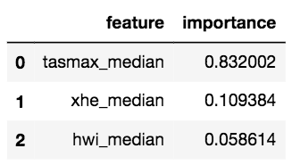
Random Forest Regression Results
Comparing RMSE: Number of Hospitalizations
Baseline (Entire Dataset) | All 3 Climate Indicators | Avg. High Temp + Ext. Heat Events | Average High Temp Only
138.61 | 116.88 | 119.93 | 121.06
Despite the low relative importance for Heat Wave Incidents, including it did produce a lower RMSE

Slide 23
Next Steps
Both of these models could benefit from much more data. Data for 5 years for two dozen cities simply isn't enough to create a model with reasonable predictive value.
To improve these models, a few next steps would be:
Finding more complete hospitalization data (preferably at a city level, rather than state)
Collect climate indicator data for many more cities
Add in socioeconomic and demographic data (e.g., age)
Test additional climate indicators
Focus on a particular region
Once model is improved, test it for future climate projections, e.g., to 2050 and 2100

Slide 24

Thanks!
Emily Nilson
emily.nilson@wri.org

